Slide 1
Skill Building Daily & Encounter Note

Slide 2
Why is it important?!
Documenting clients encounter notes is an integral part of practice workflow.
The purpose of encounter notes is to provide a daily account of your client development in their goals for all of those who share in their care.
It documents the level of Asst. Provided daily.
Is required by DHMAS .
Is use for billing purposes.

Slide 3
What information should be included?
Level Of Assistance (LOA)
MAXIMUM ASSISTANCE: Unable to meet minimal standards of behavior or functioning in order to participate in daily living activities or performance of basic tasks approx. 75% of the time. Cue – Step by step physical gestures, pointing and demonstrations Prompts/Coaching - Step by step physical demonstrations with visual and verbal directions that prompt the participant to perform the skills and/or tasks.
MODERATE ASSISTANCE – Needs constant cognitive assistance such as 1:1 cueing, prompting/coaching or demonstrations to sustain or complete simple, repetitive activities or tasks safely and accurately approx. 50% of time. Cues - Hints to help organize thoughts. Prompts/Coaching – Step by step verbal directions.
MINIMUM ASSISTANCE – Needs periodic cognitive assistance (cueing and/or prompting/coaching) to correct mistakes, check for safety and/or solve problems approx. 25% of time. Cues -Hints related to the task. Prompts/Coaching – Step by step written and/or verbal directions. 
STANDBY ASSISTANCE: Supervision by one person is needed to enable the individual to perform new procedures for safe and effective performance. Cues – Visual demonstrations related to the task. Prompts/Coaching – Visual and physical directions that prompt the participant to perform the skills and/or tasks.
 INDEPENDENT: No physical or cognitive assistance needed to perform activities or tasks.

Slide 4
Where do comments on LOA go and what should I write?
LOA's are written in the( Today's Goal) section on the back of the encounter note.
Examples of LOA comments
Bathing, Dressing – LOA 1 = (Clients name) Independently bath and dress today.
Change linens, Discard garbage- LOA 2= RA provided Stand by Asst. Cueing and coaching to change linens and discard trash.
Wash, Dry clothes- LOA 3= Minimum Asst.provided prompting client while washing and drying clothes.
Meal Planning, Safe cooking habits- LOA 4 = RA provided Moderate Asst. Coaching meal planning and cueing safe cooking habits.
Mop floor, Clean kitchen – LOA 5= Maximum Asst. Provided moping floor and cleaning kitchen.

Slide 5
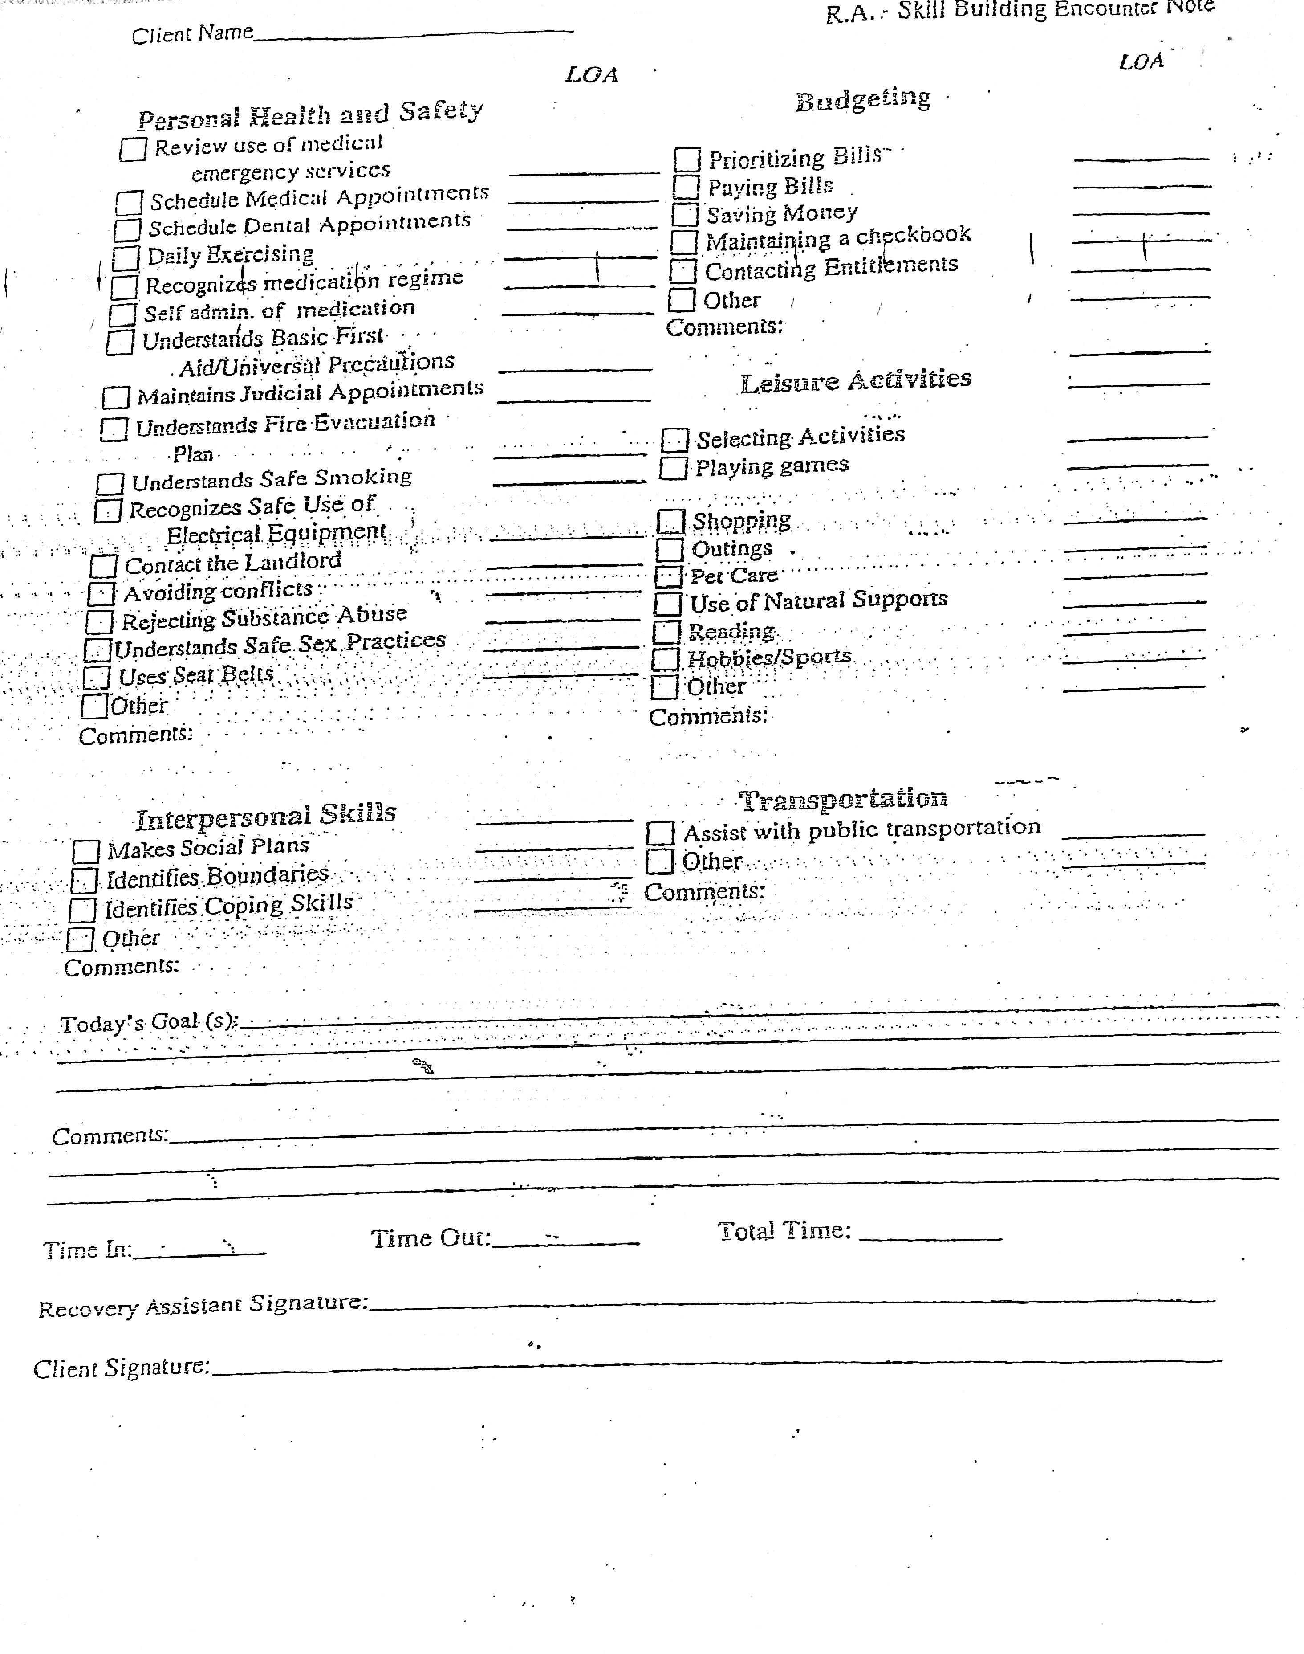
Skill Building Daily & Progress Encounter note
Only write notes related to your work with your client

Slide 6
What shouldn't be included in "Todays Goals" comments ?
Client was napping
RA Transported
RA Droved client
Any opinions about the client or allegations
If is not part of the recovery plan
Recommendations

Slide 7
Make sure all required Fields are filled accurately.....
Client Name
Staff Name
Date of services
Task completed that day
Level of Asst. Provided
Today's Goal comments
Time IN & OUT
Staff & CLIENT Signature
Incomplete encounter notes will be return to RA.

