Slide 1

Winter Storm Safety
Annual Safety Training
Prestige C&H

Slide 2

Goals of this training
After this training, you should be better able to ...
1. …be familiar with types of winter conditions
2. …know of and how to avoid winter-related injuries
3. …drive more safely in winter storm conditions
4. …know how a little about how we approach winter here at Prestige C&H

Slide 3
Let’s Begin
A major winter storm can be lethal.
Preparing for cold weather conditions and responding to them effectively can reduce the dangers caused by winter storms.

Slide 4
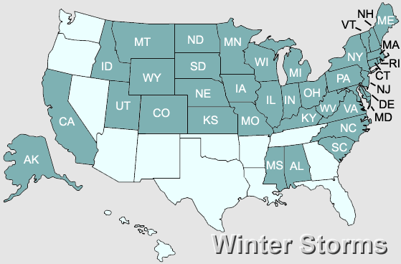
Why We Are Talking About Winter Storms?
The American Red Cross has designated the areas highlighted as susceptible to winter storms (See the map to the right).
Heavy snow, freezing rain, ice, and winds can impede roadways and make travel in and exposure to these elements dangerous.

Slide 5
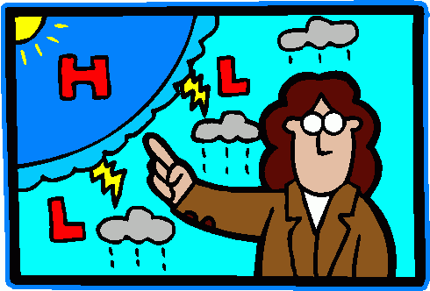
Winter Storm Conditions
Winter Storm Watch
Severe weather is possible, staff should listen to local TV/radio for updates and be alert for changing weather conditions and limit any unnecessary travel
Winter Storm Warning
Severe weather is expected, staff should remain indoors whenever possible.

Slide 6
Winter Storm Conditions
Blizzard Warning
Severe weather with heavy snowfall, near zero visibility, potential snow drifts, and sustained winds of over 35 MPH are expected.
Traveler’s Advisory
Severe weather conditions may make travel difficult or dangerous. Unnecessary travel should be limited/cancelled.

Slide 7
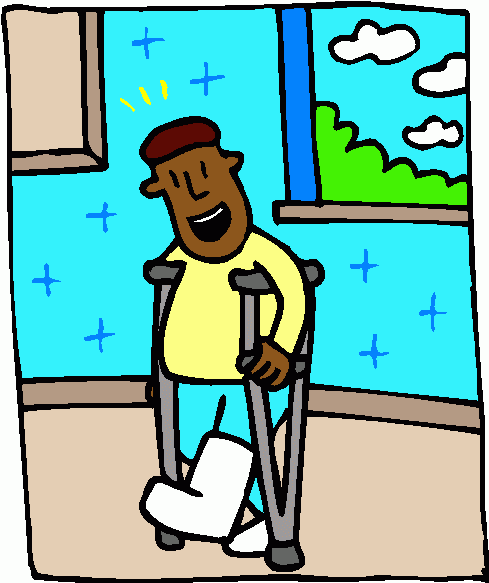
Injuries Related to Cold Weather
According to the National Weather Service, about 70 percent of injuries during winter storms result from vehicle accidents and about 25 percent of injuries result from being caught out in the storm.

Slide 8
Injuries Related to Cold Weather
Some of the hazards associated with working in winter storms include:
Driving accidents due to slippery roadways
• Carbon monoxide poisoning
• Slips and falls due to slippery walk-ways
• Hypothermia and frostbite due to the cold weather exposure
• Being struck by falling objects such as icicles, tree limbs, and utility poles
Electrocution due to downed power lines or downed objects in contact with power lines

Slide 9
Injuries Related to Cold Weather
Some of the hazards associated with working in winter storms include:
Falls from heights (e.g. falls from roof or skylights while removing snow)
• Roof collapse under weight of snow (or melting snow if drains are clogged)
• Burns from fires caused by energized line contact or equipment failure
• Exhaustion from working extended shifts
• Dehydration
• Back injuries or heart attack while removing snow

Slide 10
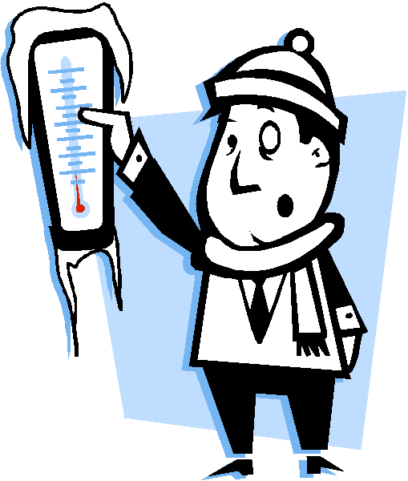
Frostbite & Hypothermia
Frostbite
Damage to body tissue caused by extreme cold
Exposure to –20 degree weather for less than 30 minutes can result in frostbite
Symptoms: loss of feeling and white/pale appearance in the extremities
Actions: get medical treatment immediately; if you must wait, slowly re-warm the affected areas

Slide 11
Frostbite & Hypothermia
Hypothermia
Occurs when an individual’s body temperature is below 95 degrees
Hypothermia can be fatal or cause permanent organ damage.
Symptoms: uncontrollable shivering, memory loss, disorientation, incoherence, slurred speech, drowsiness
Actions: get medical attention immediately; work on re-warming the body’s core first (warming extremities can draw cold blood to vital organs); do not give coffee, alcohol, or drugs

Slide 12
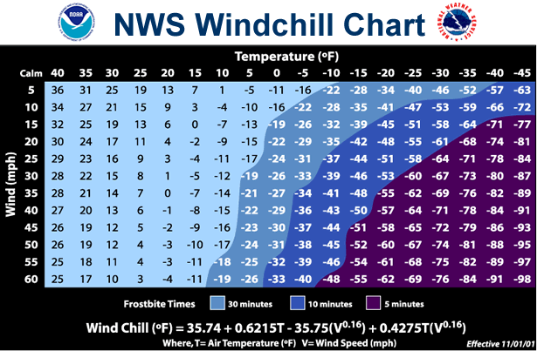
Frostbite & Hypothermia
This NWS Windchill Chart can serves as a guide on how long it is safe to remain outdoors in cold weather

Slide 13
What can be done to avoid frostbite and hypothermia?
Frostbite & Hypothermia
Recognize and respect the conditions that lead to potential cold-induced illnesses and injuries.
Remember the symptoms of and actions for frostbite and hypothermia
Select proper clothing for cold, wet, and windy conditions.
Layer clothing to adjust to changing environmental temperatures.
Wear a hat and gloves, in addition to under-wear that will keep water away from the skin (polypropylene).
Take frequent short breaks in warm dry shelters to allow the body to warm up.
Perform work during the warmest part of the day if possible
Avoid exhaustion or fatigue - energy is needed to keep muscles warm.
Drink warm, sweet beverages (sugar water, sports-type drinks).
Avoid drinks with caffeine (coffee, tea, or hot chocolate) or alcohol.
Eat warm, high-calorie foods like hot pasta dishes.

Slide 14
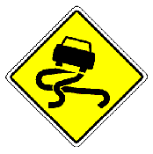
Traveling in Winter Weather
Preparing Your Car
Make sure car has sufficient fuel and is in good repair
“Winterize” your car (check car battery, fluids, exhaust, heater, lights, ignition system, antifreeze level, and tires);
Make sure battery cables are in your car
Keep a “Winter Emergency Kit” in your car
distress flag/flares
blanket and extra warm clothing
traction aid (I.e., sand kitty litter
cell phone
water & non-perishable/high caloric snack food,
flashlight,
battery powered radio, extra batteries,
windshield scraper

Slide 15
Traveling in Winter Weather
Preparing Yourself
Dress warmly
Try to travel only in daylight and on well traveled roads
Try not to travel alone
Keep others informed of your schedule and the routes you intend to take
Keep your cell phone handy and charged

Slide 16
Traveling in Winter Weather
If You Are Stranded…
Do not leave their vehicle unless a building is close and safe.
If not, remain in your car, tie a bright covered cloth to the antennae, raise the hood and wait for help.
If you need warmth, turn on the vehicle for short periods of time (i.e., 10 minutes) and run the heater. Be aware of carbon monoxide poisoning – make sure the exhaust is clear of snow and a (downwind) window is slightly open to prevent asphyxiation.
Watch for signs of frostbite and hypothermia. Do minor exercises (clap hands and move arms and legs occasionally) to keep up circulation.. For warmth, use newspapers, maps, even the floor mats for added insulation.

Slide 17
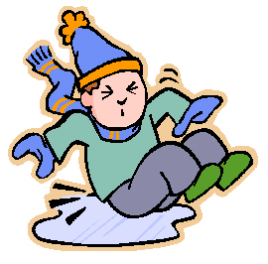
Walking Safely on Snow and Ice
Here are some helpful hints:
Wear proper footwear: well insulated, good rubber treads
Have available rubber overshoes that fit over your shoes
When walking on an ice or snow, take short steps and walk at a slower pace so you can react quickly to a change in traction.
If you cannot walk on an uncleared sidewalk and are forced to walk in the street,
Walk against the traffic and close to the curb as you can.
Be on the lookout for vehicles that may have lost traction and are slipping towards you.
Be aware that approaching vehicles may not be able to stop at crosswalks or traffic signals.
At nighttime, wear bright clothing or reflective gear
During the day, wear sun-glasses to help you see better

Slide 18
Winter Weather
Staff should always use their personal judgment when
determining if weather conditions are safe for travel or attendance at work.
Always make the
safety of your clients and you the main priority!

Slide 19
Winter Weather
Weather Alert Radios
Prestige C&H’s Administrative Assistant receives email/desktop notices of weather-related warnings or watches from local weather authorities.
Weather related issues are monitored (via the Weather Alert Radio).
The Executive Director or Designee will communicate conditions to all units and determine if the agency should remain open. Staff will be made aware of the conditions during these times.

Slide 20
Winter Weather
Staff are encouraged to arrange their work schedule as needed so that their safety, and the safety of their clients, is assured.
This arrangement should be done in concert with their supervisor and be in accordance with existing agency Personnel Policy.

Slide 21
The
End

Slide 22

TEST
T F If a Winter Storm Watch is issued, you can be sure that a winter storm is expected and imminent.
T F The vast majority of injuries that occur as a result of winter weather is attributable to exposure to the elements (frostbite and hypothermia)
T F If you are stranded in your car during a winter storm, stay in your car and keep the motor running constantly. This will assure that you will remain warm.

Slide 23
TEST
4. T F Frostbite involves damage to the body tissue whereas hypothermia occurs when the body’s core temperature drops dangerously low. Both can occur during exposure to winter elements.
5. T F Hot coffee and tea are recommended for people suffering from hypothermia to help raise their core temperature.
T F Proper clothing and dressing in layers are two of the most important means to prevent winter-related exposure injuries.

Slide 24
TEST
7. T F You can always assume that Prestige C&H is closed if there is a Traveler’s Advisory, Winter Storm Warning, or Blizzard Warning in your community.
8. T F You must come in to work if Prestige C&H is open, even during Winter Storm Warning or Watch.

