Slide 1

Unsafe Environmental Factors
Annual Safety Training

Slide 2

Goals of this training
After this training, you should be better able to
… identify potentially hazardous materials
… know what Material Safety Data Sheets are and where they are located
… realize ways to minimize risk associated with hazardous materials

Slide 3

Hazard Communication Standards
The Occupational Safety and Health (OSHA) standard on
Hazard Communication (CFR 1910.1200) states that
“employees have both a need and right to know the hazards and identities of the chemicals
they are exposed to when working”

Slide 4
Hazard Communication Standards
Here at Prestige C&H:
we keep track of Hazardous Materials used at the agency
available to each employee are the agency’s
Written Emergency Response Plan and
Material Data Safety Sheets (MSDS)
staff are trained on Emergency Procedures at the time of orientation and at least once a year thereafter

Slide 5

Hazardous Materials
What do we mean by “Hazardous Materials”?
These include “any chemical substance which, when released or misused, can pose a threat to the environment or to personal health”

Slide 6
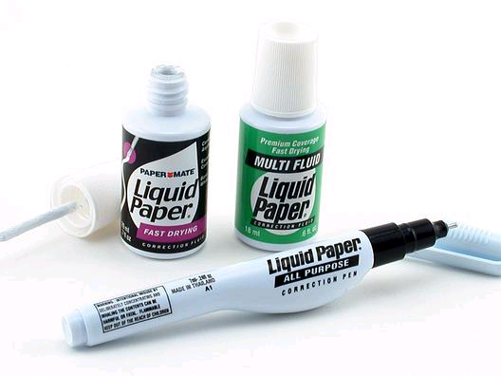


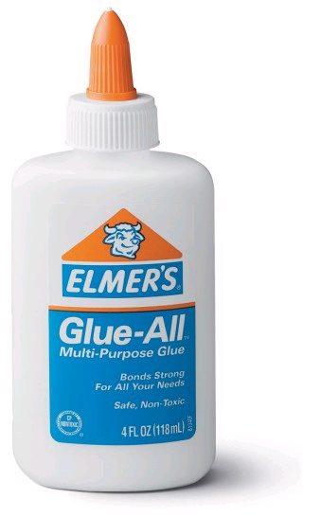
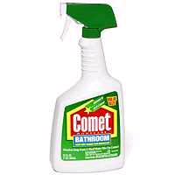
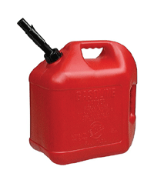
Hazardous Materials
Here are some examples of “Hazardous Materials” that may be found here at Prestige C&H:
White-out
Air Fresheners
Hand Soap
Cleaners
Gasoline
Glue

Slide 7



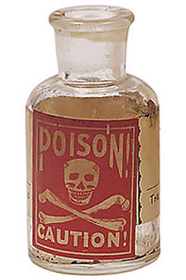
Hazardous Materials
“Hazardous Materials” include substances from the following categories:
flammables combustibles explosives
Corrosives irritants
Toxins and Poisons
Carcinogens
… and any other materials that may cause injury, illness or harm to health

Slide 8

Hazardous Communication Plan
The agency’s Emergency Response Plan
can be found with the Policies and Procedures binder
addresses:
Material Data Safety Sheets for hazardous substances present at Prestige C&H
Labeling of hazardous materials in containers that are unmarked or poorly labeled
Ways to minimize risk
Actions to take in the event of an accident or exposure

Slide 9

Material Safety Data Sheets (MSDS)
MSDS Sheets
most often provided by the manufacturer of chemicals
summarize
the hazards,
handling, and
emergency care in the event of accidental ingestion of or contact with a hazardous substance

Slide 10
Material Safety Data Sheets (MSDS)
MSDS Sheets at Prestige C&H
kept in clearly marked binders in a central, accessible area
individuals who require emergency medical care after the ingestion/exposure of a hazardous material should take a copy of the MSDS for that substance with them to a medical facility

Slide 11

Labeling
All hazardous materials at Prestige C&H must be kept in containers that are clearly marked and labeled.
Whenever possible, hazardous substances should be kept in it’s original container
When the original label is missing or not legible, the hazardous material must be labeled using the agency’s Container Label

Slide 12
Name of Chemical
Type of hazard
Refers to MSDS

Slide 13
Minimizing Risk
Below are some helpful hints to keep Prestige C&H safe:
let your Supervisor know when you or others bring any chemicals into the building
in the event of an emergency involving accidental exposure:
know the location of the MSDS binder
contact Poison Control or 911 immediately
make a copy of the MSDS sheet to accompany the individual to the hospital
REMEMBER! Toxic chemicals are NOT allowed in the building unless required and authorized by administration

Slide 14
Points To Remember
1. Hazardous substances include “any chemical substance
which, when released or misused, can pose a threat to
the environment or to personal health”. This may
include substances that are inhaled, ingested, or touched.
2. Hazardous materials may include items you may
consider “safe” or that you use every day.
3. It is the responsibility of agency staff to inform their
Supervisor when they or others bring a chemical into the
building

Slide 15
More
Points To Remember
4. The Management Team will be responsible for providing MSDS sheets on the chemicals present in the building
5. MSDS sheets provide important information such as the
hazards, handling and emergency care associated with
that chemical
6. The MSDS sheets at Prestige C&H can be found in a central, accessible location
7. The agency’s Emergency Response Plan can be found
in the Policy and Procedure’s binder

Slide 16
More
Points To Remember
8. To minimize risk, staff should know the location the
their unit’s MSDS binder, report the presence of all
chemicals to their Supervisor, and refrain from bringing
to work substances that may be hazardous to others.
9. In the event of an emergency exposure/ingestion, staff
should call 911 or Poison Control, make a copy of the
MSDS sheet, and answer medical personnel questions as
possible
10.Avoid contact with substances or exposed individuals
until you are assured of your safety.

Slide 19

Hazard Communication
Test
1. T F Prestige C&H keeps track of Hazardous Materials brought into the agency by visitors and staff.
2. T F You know a substance is considered to be hazardous only by looking for the “skull and crossbones” symbol on it’s label.
3. T F The Prestige C&H Hazardous Communications Plan contains information on labeling of materials, ways to minimize exposure risk, and actions to be taken in the event of exposure.
4. T F MSDS sheets should accompany anyone exposed to a hazardous substance and needs treatment for this contact.

Slide 20
Hazard Communication
Test
5. T F MSDS sheets can only be found in a binder in the Executive Director’s office.
6. T F Staff must let their Supervisor know when they bring in a substance only when they think the substance is an exposure risk.
7. T F Exposure to a substance may include inhaling, touching, or ingesting.
8. T F You may report concerns regarding communicable diseases to your Supervisor only when you are sure of or have documentation that the person has the illness.

